Slide 1
Cost Code
Andesit
Prepared by
FINANCE DEPARTMENT
PT. Ametis Energi Nusantara
7th MEI 2014

Slide 2
Phase 1
Identify Opportunity
VISION
BACKGROUND
In Accordance with rapid growth of Andesit Project, Ametis will develop reliable and competence system fits with Project Needs
Andesit Project will run right away (on August)
The complexity of Mining Project is excessively especially regarding cost controlling and cost monitoring
Management needs concise, prompt and accurate report

Slide 3
Phase 1
Identify Opportunity
Opportunity (Problem) Statement
To meet the needs of cost controlling and cost monitoring Budget and Actual expense in timeline basis from Andesit Project, it requires the system that fit with those needs

Slide 4
Phase 1
Identify Opportunity
Framing
Objectives:
Develop system fits with Project needs in Budget and Cost Controlling and Monitoring with timeline basis
Focus of attention
Out scope :
AEN Finance System
In scope :
Budget and Cost Controlling of Andesit Project
Budget and Cost Monitoring of Andesit Project
Vision of success :
Ametis will develop reliable and competence system fits with Project Needs
Metric of success :
Budget and Cost can be controlled and monitored accurately
All user(Project Teams, Finance and Management) can use the system easily

Slide 5
Phase 1
Identify Opportunity
Framing
AEN do not have automatically Finance system both for operational and project needs
Future
Focus
Given
Develop system for Project Needs in Budget and Cost Controlling and Monitoring with timeline basis
AEN Finance will have automatically system for Operational and Project Needs

Slide 6
Phase 1
Identify Opportunity
Strength
AEN have three IT Expertise
Weakness
IT Engineer whose in charge still inexperienced
Limited fund available
Andesit Project already have cost group details

Slide 7
Phase 1
Identify Opportunity
Opportunity
AEN Projects still in early phase
Threat
The project expenses is already increasing

Slide 8
Phase 1
Identify Opportunity
Flow Process

Slide 9
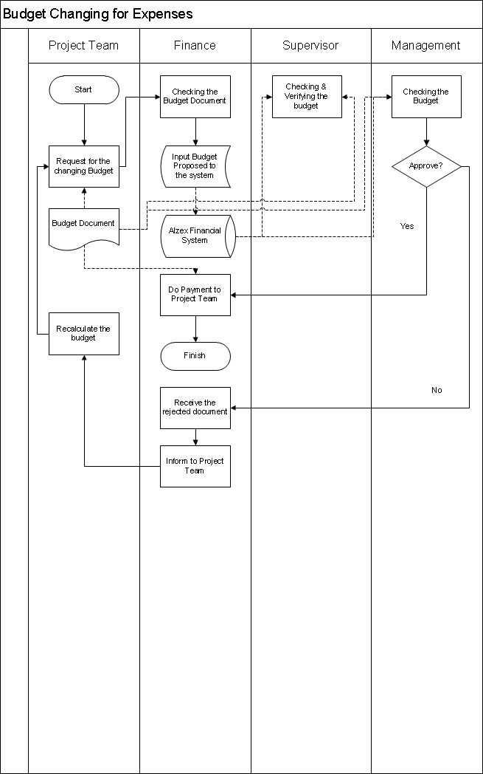
Phase 1
Identify Opportunity
Flow Process

Slide 10
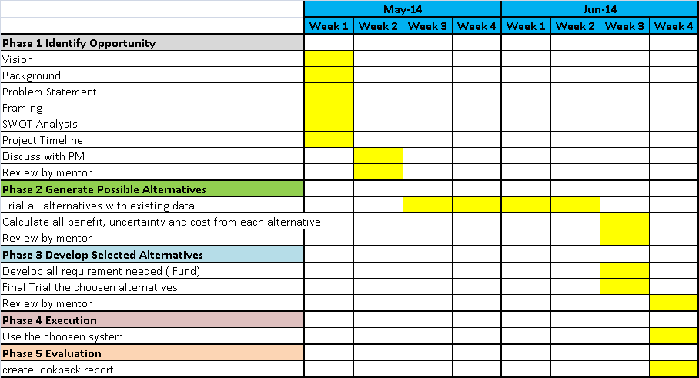
Phase 1
Identify Opportunity
Project Time Line

Slide 11
Phase 2
Generate Possible Alternatives

Slide 12
Phase 3
Develop Selected Alternatives

